Slide 1
Image Processing using Convolution neural network
By:
Ashok Vardhan Addala

Slide 2
Content:
Introduction
Why CNN?
Layers used to build ConvNets
Terminology
Applications
Demo
References

Slide 3
Introduction:
Image Classification is the task of assigning an input image one label from a fixed set of categories.
This is one of the core problems in Computer Vision that, despite its simplicity, has a large variety of practical applications.
Challenges: Viewpoint variation, Scale variation and Deformation

Slide 4
Why CNN?
Neural Network don’t scale well to full images.
Images of size 32x32x3 (32 wide, 32 high, 3 color channels), would need 32*32*3 = 3072 weights.
Image of more respectable size, e.g. 200x200x3, would lead to neurons that have 200*200*3 = 120,000 weights.
The huge number of parameters would quickly lead to overfitting.

Slide 5
Why CNN?
The layers of a ConvNet have neurons arranged in 3 dimensions: width, height, depth.
Convolution is a function derived from two given functions by integration that expresses how the shape of one is modified by the other.
Convolutional neural networks allow networks to have fewer weights and they are given a very effective tool for image processing.

Slide 6
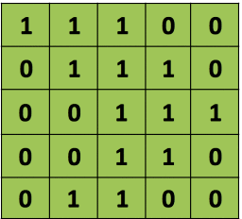
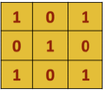
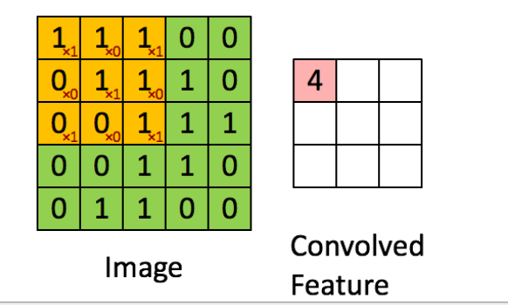
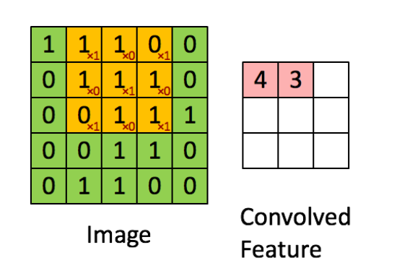
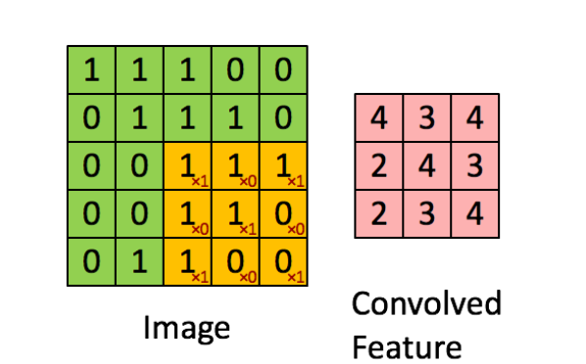
Image Matrix
Filter Matrix
Convolved Matrix

Slide 7
Layers used to build Convnets:

Slide 8
Terminology:
Dropout
Backpropagation
Learning Rate
Decay

Slide 9
Applications:
Image Classification
Face Recognition
Speech NLP
Medical Imaging
Seismic Imaging & Interpretation

Slide 10
Demonstration:
CIFAR10 Dataset
CIFAR100 Dataset

Slide 11
Resources:
Convolution Neural Network Course
Video Lectures
Keras
Project Repository

Slide 12
Thank You

